Slide 1
Example of programming a quantum robot
This program can be easily changed to the following types of control:
Boolean Logic
Fuzzy logic
Probabilistic logic
Ternary logic
Mixed logic
Your own control for any algebra you may want

Slide 2
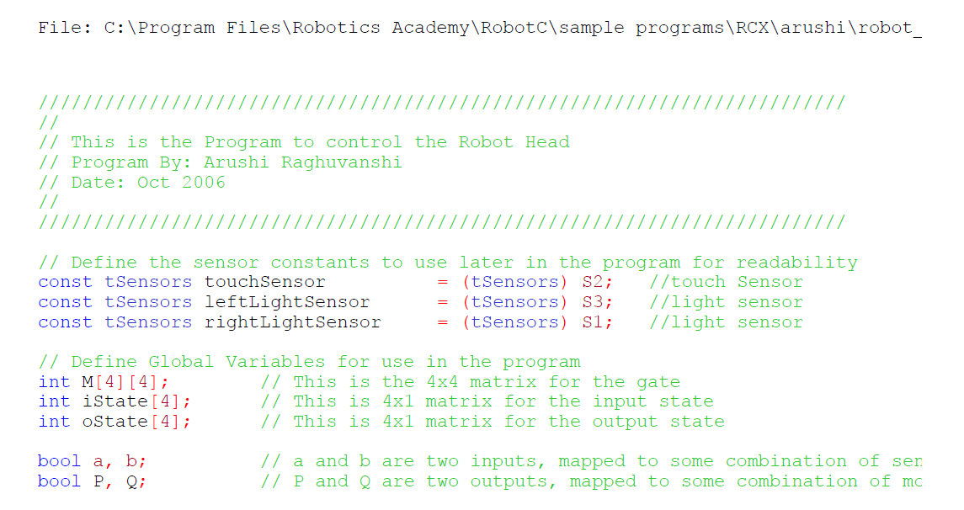

Slide 3
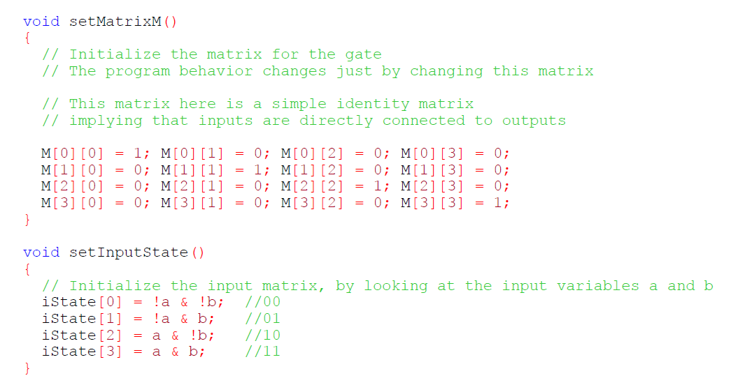
Review matrices and vectors
Review how to multiply matrix by vector
Review how to multiply matrix by matrix

Slide 4
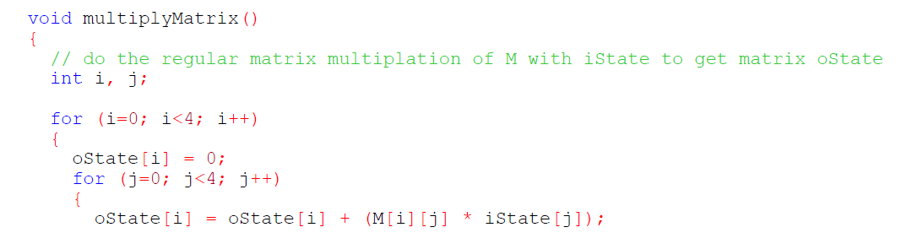
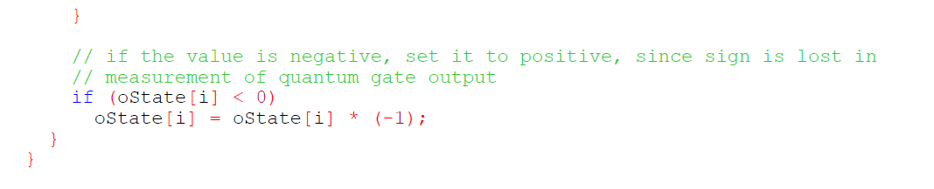
Review quantum measurement
Review probability

Slide 5
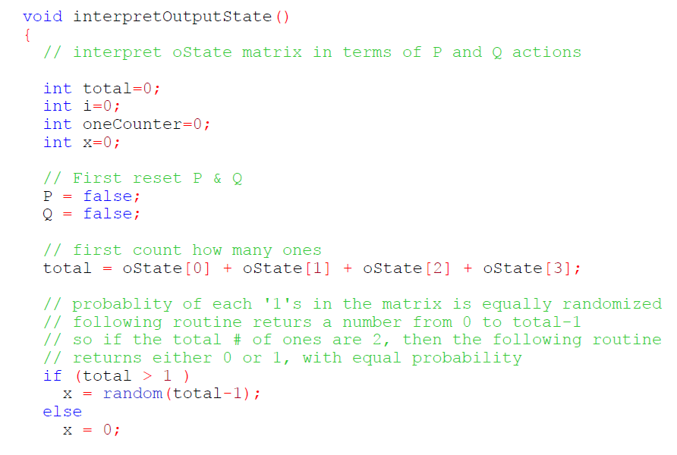
Initialize total
oneCounter counts ones
Calculate new value of total
Calculate value of output

Slide 6
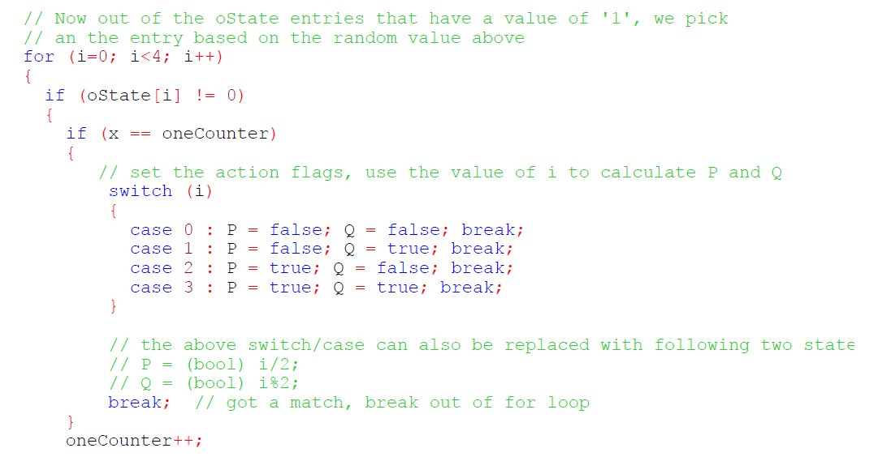
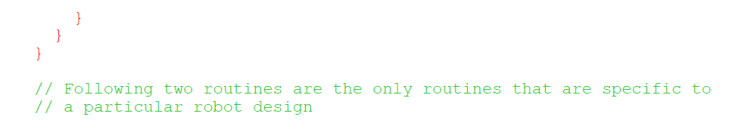
Continue of subroutine of interpreting the output state
Calculate deterministic values of control variables P and Q
Loop for oneCounter

Slide 7
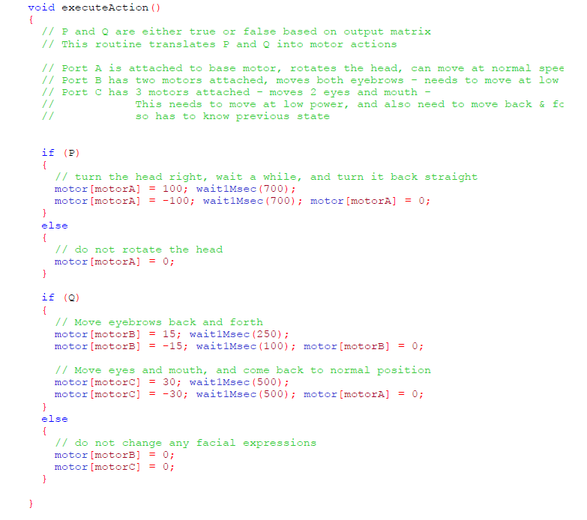
Translates output Boolean variables P and Q to actions of motors
Output Motion routine is for motors

Slide 8
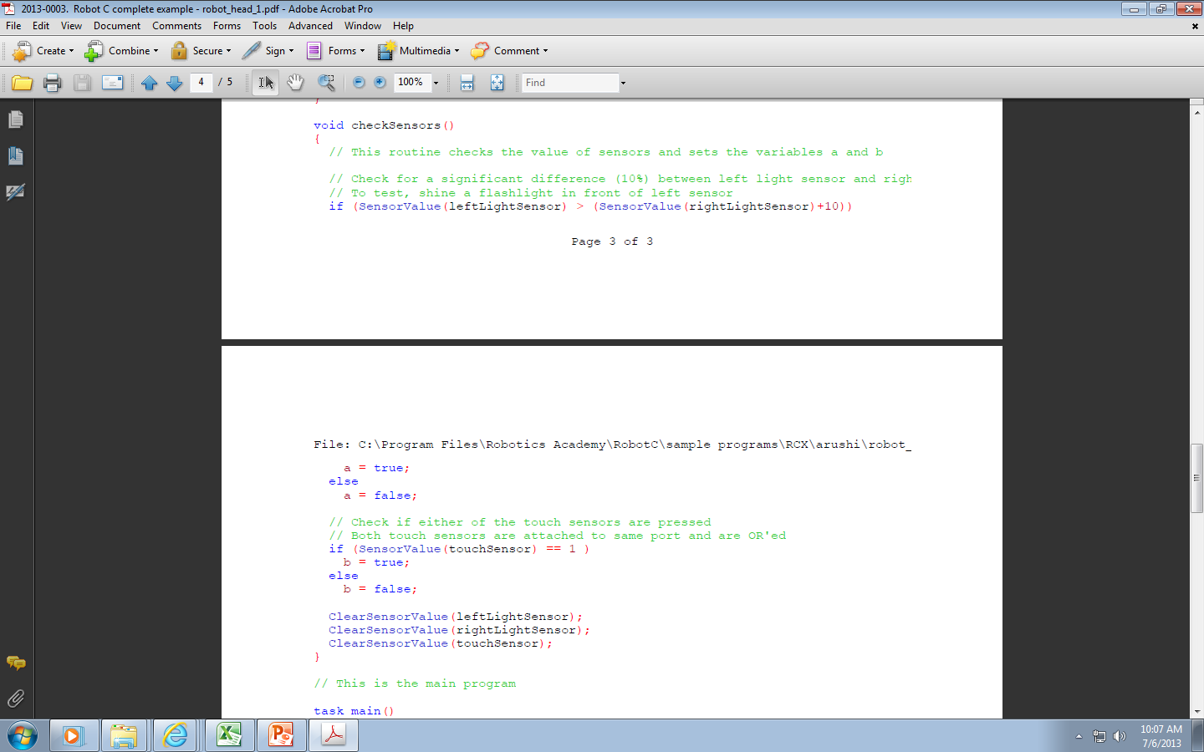
Converts sensor reading to input variables a and b
Two light sensors and touch sensor
Input routine is for sensors
Two light sensors and touch sensor

Slide 9
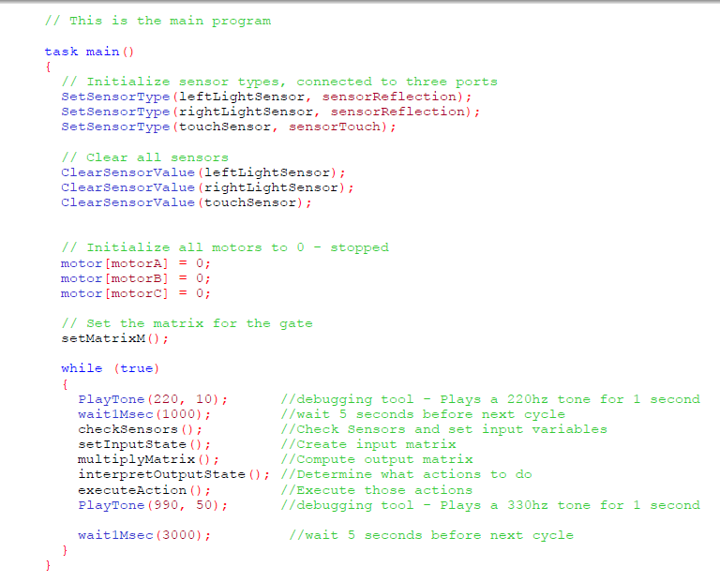
Main program links inputs, outputs and brain (behavior)
Intialize all
input
brain
output

